Slide 1




Temporal Network Embedding
with Micro- and Macro-dynamics
Yuanfu Lu¹, Xiao Wang¹, Chuan Shi¹, Philip S. Yu², Yanfang Ye³
¹Beijing University of Posts and Telecommunications, Beijing, China
²University of Illinois at Chicago IL, USA
³Case Western Reserve University, OH, USA

Slide 2

1
Background
CONTENTS
2
$${\text{M}}^{\text{2}}\text{DNE}$$
3
Experiments
4
Conclusions

Slide 3

1
Background
CONTENTS
2
$${\text{M}}^{\text{2}}\text{DNE}$$
3
Experiments
4
Conclusions

Slide 4


Background | An Instance of Temporal Network
Jack
2019.11.06
2019.11.05
2019.11.05
Penny
2019.05.22
2019.05.22
2019.11.06
2019.08.08
2019.08.08
2019.09.13
Tom
2019.09.13
Time
2019.11.05
2019.11.06

Slide 5
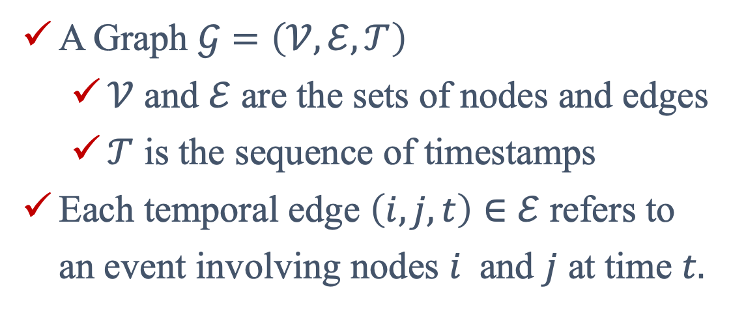
Background | Definition of Temporal Network
A Graph $𝒢=\left(𝒱, ℰ, 𝒯\right)$
$𝒱$ and $ℰ$ are the sets of nodes and edges
$𝒯$ is the sequence of timestamps
Each temporal edge $\left(i, j, t\right)∈ℰ$ refers to an event involving nodes $i$ and $j$ at time $t.$
2019.11.06
2019.11.05
2019.05.22
2019.11.06
2019.08.08
2019.09.13
A temporal network refers as a sequence of timestamped edges, where each edge connects two nodes at a certain time.
A. Li, S. P. Cornelius, Y.-Y. Liu, L. Wang, and A.-L. Barabási. The fundamental advantages of temporal networks. Science 358, 6366 (2017), 1042–1046.

Slide 6
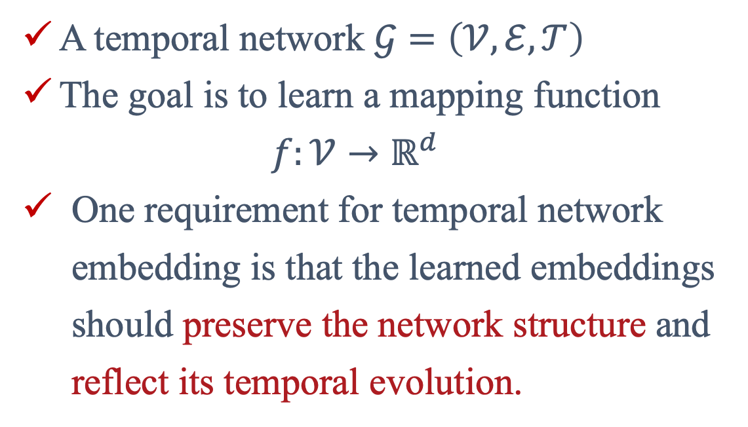
Background | Temporal Network Embedding
A temporal network $𝒢=\left(𝒱, ℰ, 𝒯\right)$
The goal is to learn a mapping function
$$f:𝒱→ℝ^{d}$$
One requirement for temporal network embedding is that the learned embeddings should preserve the network structure and reflect its temporal evolution.
2019.11.06
2019.11.05
2019.05.22
2019.11.06
2019.08.08
2019.09.13

Slide 7
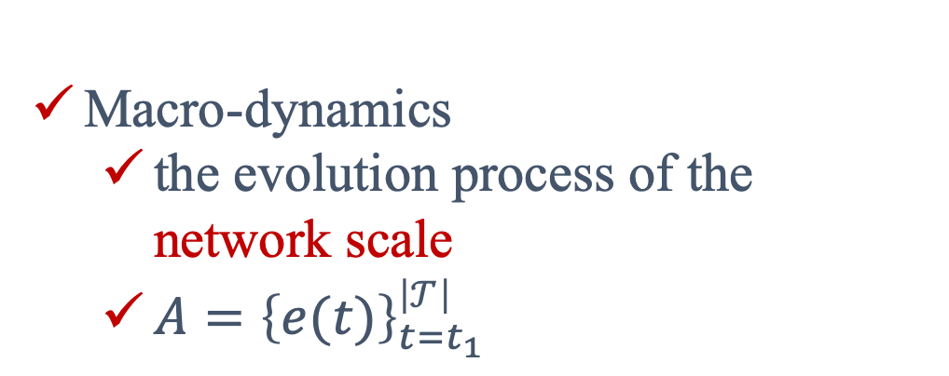
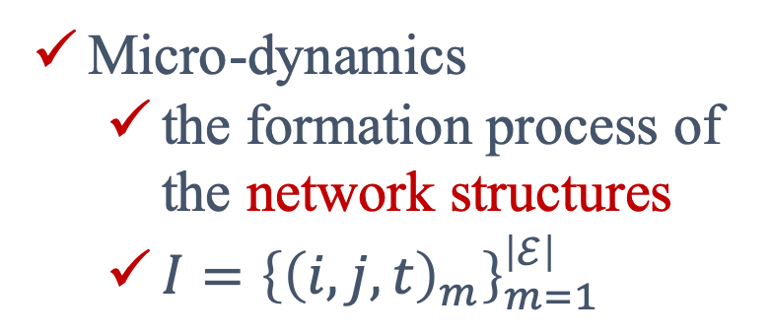
Background | Micro- and Macro-dynamics
Micro-dynamics
the formation process of the network structures
$I={\left\{{\left(i,j,t\right)}_{m}\right\}}_{m=1}^{\left|ℰ\right|}$
2019.11.06
2019.11.06
2019.11.05
2019.11.06
2019.05.22
2019.11.06
2019.08.08
Macro-dynamics
the evolution process of the network scale
$A={\left\{e(t)\right\}}_{t=t_{1}}^{\left|𝒯\right|}$
2019.09.13

Slide 8
Background | Related Work
Dynamic Snapshot Network
Learn node embedding for each network snapshot (DANE, DHPE…).
Detailed formation process are ignored!
Temporal Evolution Network
Consider the evolution process of the network (HTNE, DyRep…).
Ignore the fine-grained structural and temporal properties!
None of the existing method takes into account both the micro- and macro-dynamics for temporal network embedding.

Slide 9
1
Background
CONTENTS
2
$${\text{M}}^{\text{2}}\text{DNE}$$
3
Experiments
4
Conclusions

Slide 10
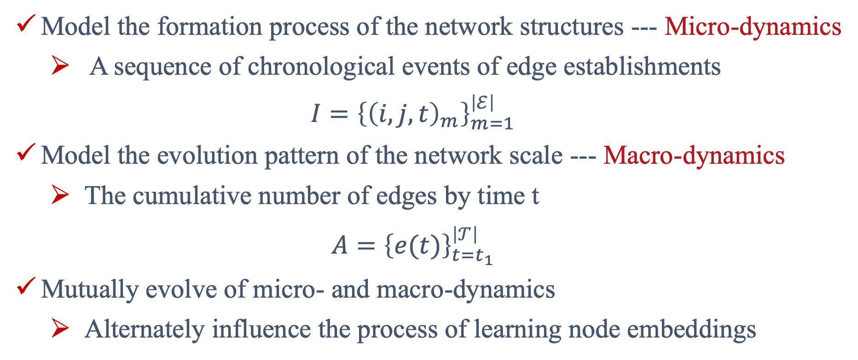
${\text{M}}^{\text{2}}\text{DNE}$ | Motivation
Model the formation process of the network structures --- Micro-dynamics
A sequence of chronological events of edge establishments
$$I={\left\{{\left(i,j,t\right)}_{m}\right\}}_{m=1}^{\left|ℰ\right|}$$
Model the evolution pattern of the network scale --- Macro-dynamics
The cumulative number of edges by time t
$$A={\left\{e(t)\right\}}_{t=t_{1}}^{\left|𝒯\right|}$$
Mutually evolve of micro- and macro-dynamics
Alternately influence the process of learning node embeddings

Slide 11
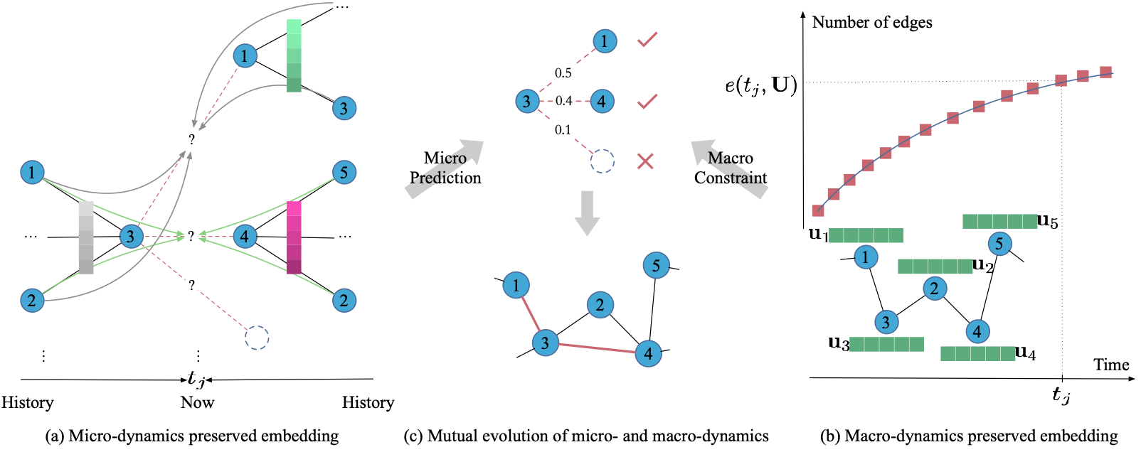
${\text{M}}^{\text{2}}\text{DNE}$ | Model

Slide 12
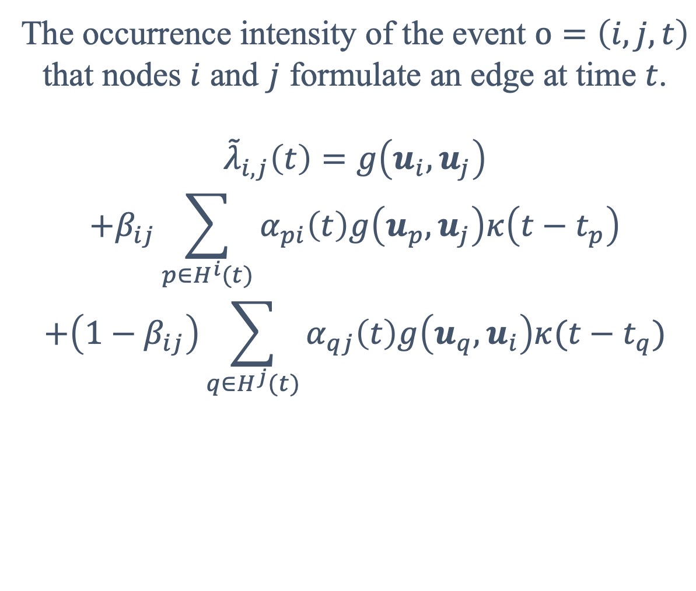
${\text{M}}^{\text{2}}\text{DNE}$ | Micro-dynamics Preserved Embedding
The occurrence intensity of the event $o=\left(i,j,t\right)$ that nodes $i$ and $j$ formulate an edge at time $t$.
$${\tilde{λ}}_{i,j}\left(t\right)=g\left(u_{i},u_{j}\right)$$
$$+β_{ij}\sum_{p∈H^{i}(t)}{α_{pi}\left(t\right)g\left(u_{p}, u_{j}\right)κ\left(t−t_{p}\right)}$$
$$+\left(1−β_{ij}\right)\sum_{q∈H^{j}(t)}{α_{qj}\left(t\right)g\left(u_{q}, u_{i}\right)κ(t−t_{q})}$$

Slide 13
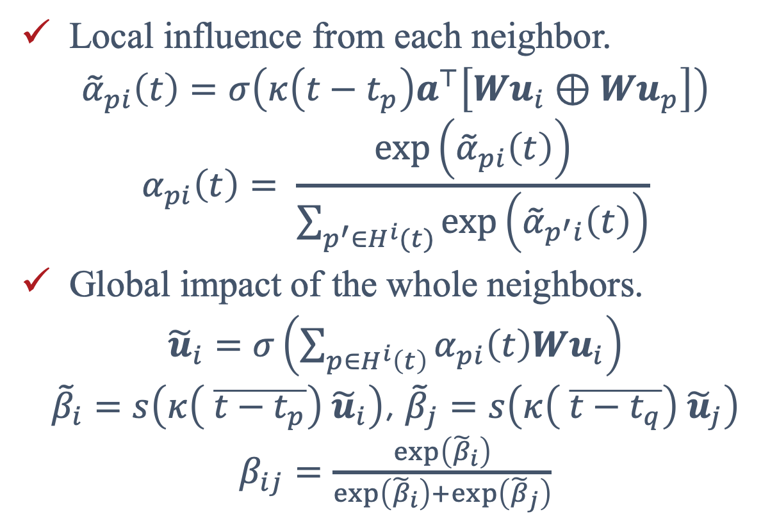
${\text{M}}^{\text{2}}\text{DNE}$ | Hierarchical Temporal Attention
Local influence from each neighbor.
$${\tilde{α}}_{pi}\left(t\right)=σ\left(κ\left(t−t_{p}\right)a^{⊤}\left[Wu_{i}⊕Wu_{p}\right]\right)$$
$$α_{pi}\left(t\right)= \frac{\exp\left({\tilde{α}}_{pi}\left(t\right)\right)}{\sum_{p^{′}∈H^{i}(t)}{\exp\left({\tilde{α}}_{p^{′}i}\left(t\right)\right)}}$$
Global impact of the whole neighbors.
${\tilde{u}}_{i}=σ\left(\sum_{p∈H^{i}\left(t\right)}{α_{pi}\left(t\right)Wu_{i}}\right)$
${\tilde{β}}_{i}=s\left(κ\left( \overline{t−t_{p}}\right) {\tilde{u}}_{i}\right)$, ${\tilde{β}}_{j}=s\left(κ\left( \overline{t−t_{q}}\right) {\tilde{u}}_{j}\right)$
$β_{ij}=$ $\frac{\exp\left({\tilde{β}}_{i}\right)}{\exp\left({\tilde{β}}_{i}\right)+\exp\left({\tilde{β}}_{j}\right)}$

Slide 14
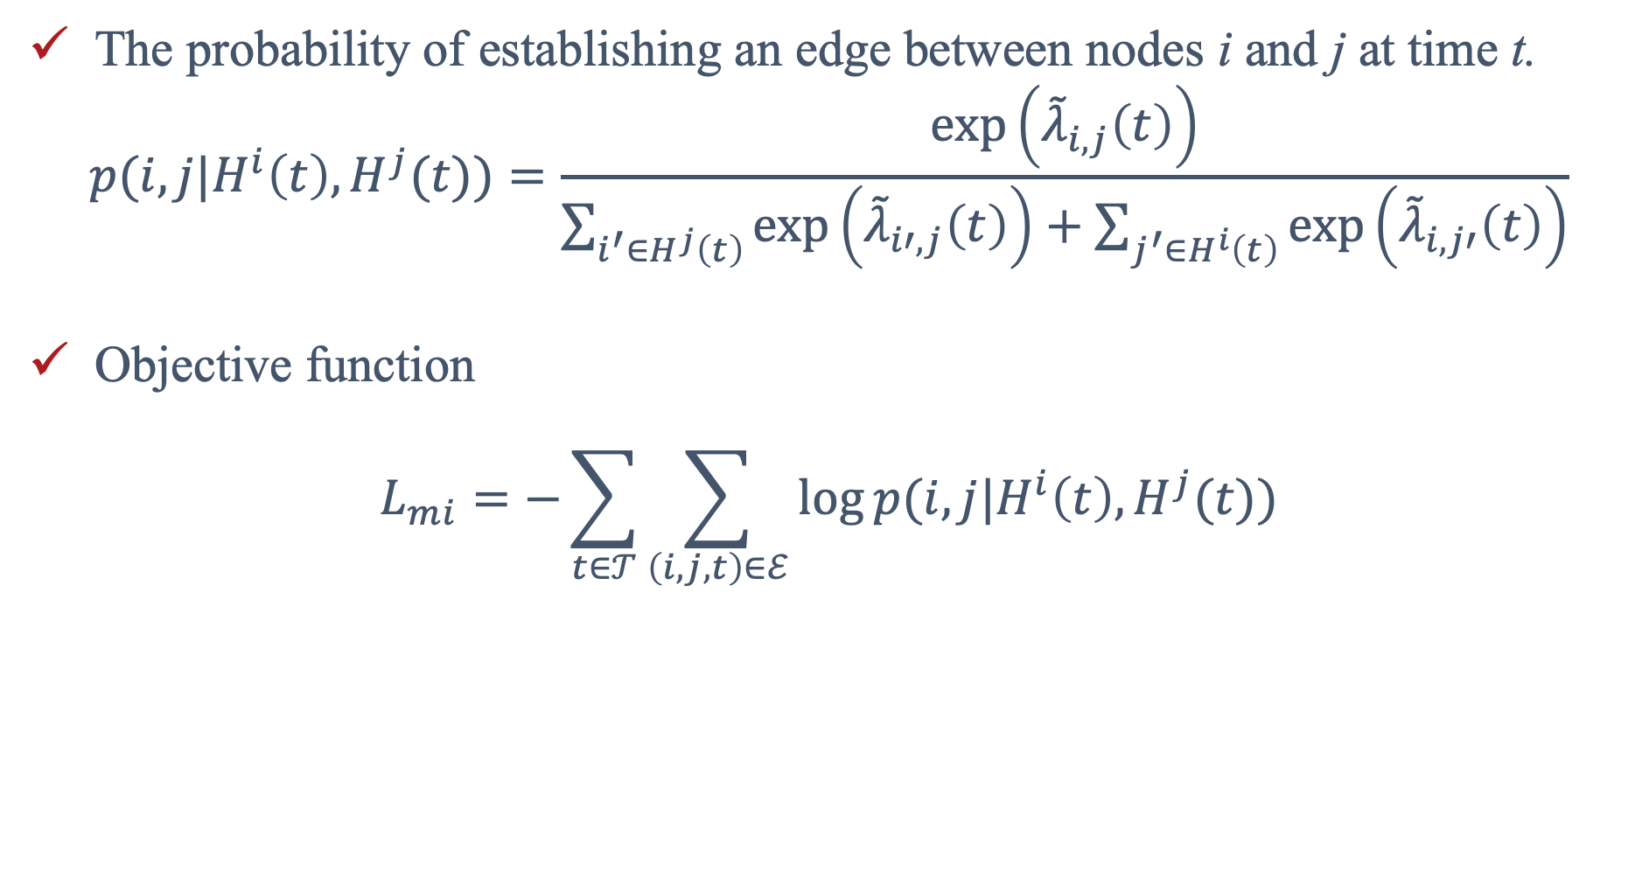
${\text{M}}^{\text{2}}\text{DNE}$ | Micro Prediction
The probability of establishing an edge between nodes i and j at time t.
$$p(i,j|H^{i}\left(t\right), H^{j}(t))=\frac{\exp\left({\tilde{λ}}_{i,j}\left(t\right)\right)}{\sum_{i^{′}∈H^{j}\left(t\right)}{\exp\left({\tilde{λ}}_{i′,j}\left(t\right)\right)}+\sum_{j^{′}∈H^{i}\left(t\right)}{\exp\left({\tilde{λ}}_{i,j′}\left(t\right)\right)}}$$
Objective function
$$L_{mi}=−\sum_{t∈𝒯}{\sum_{\left(i,j,t\right)∈ℰ}{log⁡p(i,j|H^{i}\left(t\right), H^{j}(t))}}$$

Slide 15
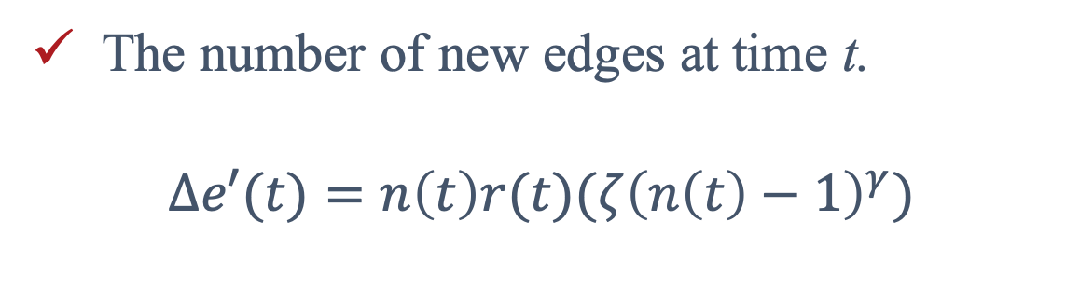
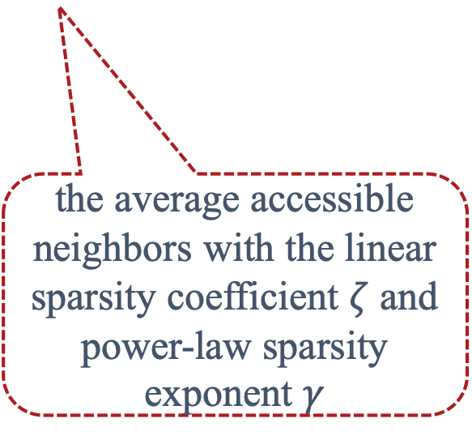
${\text{M}}^{\text{2}}\text{DNE}$ | Macro-dynamics Preserved Embedding
The number of new edges at time t.
$$Δe′(t)=n\left(t\right)r(t)(ζ{\left(n\left(t\right)−1\right)}^{γ})$$
the cumulative number of nodes by time t.
the average accessible neighbors with the linear sparsity coefficient $ζ$ and power-law sparsity exponent $γ$
for each node i, it links other nodes (e.g., node j) with a linking rate r(t) at time t.

Slide 16
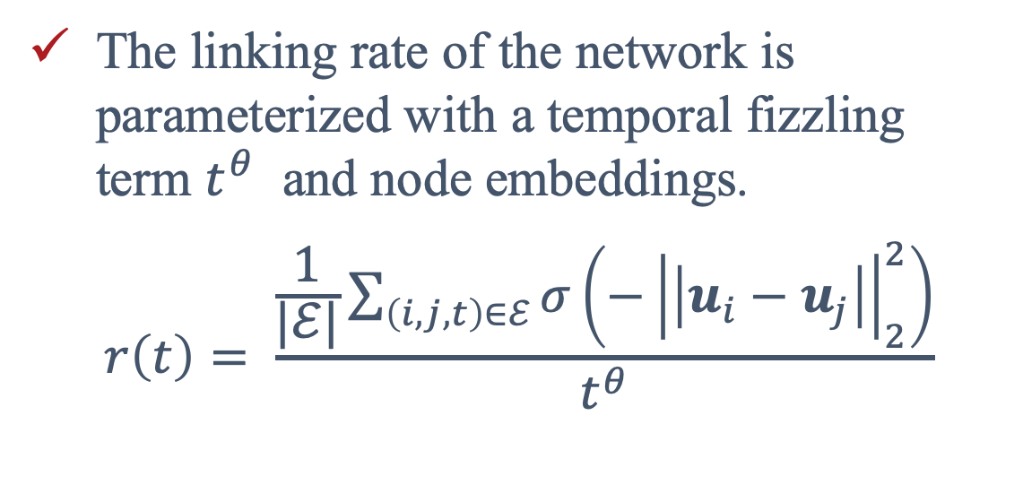
${\text{M}}^{\text{2}}\text{DNE}$ | Linking Rate
The linking rate of the network is parameterized with a temporal fizzling term $t^{θ}$ and node embeddings.
$$r\left(t\right)= \frac{\frac{1}{|ℰ|}\sum_{\left(i,j,t\right)∈ℰ}{σ\left(−{\left|\left|u_{i}−u_{j}\right|\right|}_{2}^{2}\right)}}{t^{θ}}$$

Slide 17
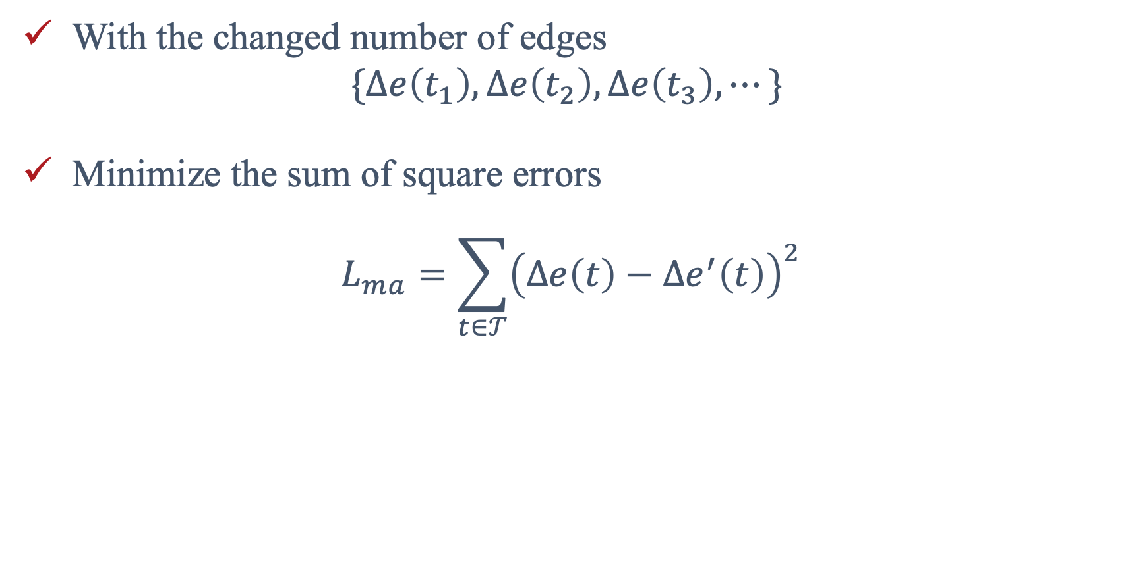
${\text{M}}^{\text{2}}\text{DNE}$ | Macro Constraint
With the changed number of edges
$$\{Δe\left(t_{1}\right),Δe\left(t_{2}\right),Δe\left(t_{3}\right),⋯\}$$
Minimize the sum of square errors
$$L_{ma}=\sum_{t∈𝒯}{{\left(Δe\left(t\right)−Δe^{′}\left(t\right)\right)}^{2}}$$

Slide 18
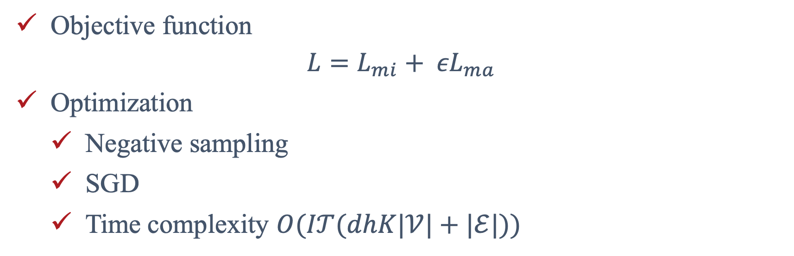
${\text{M}}^{\text{2}}\text{DNE}$ | The Unified Model
Objective function
$${L=L_{mi}+ εL}_{ma}$$
Optimization
Negative sampling
SGD
Time complexity $O(I𝒯(dhK|𝒱|+|ℰ|))$

Slide 19
1
Background
CONTENTS
2
$${\text{M}}^{\text{2}}\text{DNE}$$
3
Experiments
4
Conclusions

Slide 20
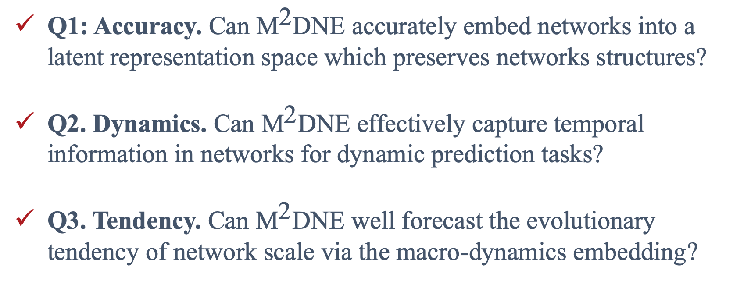
Experiments | Three Research Questions
Q1: Accuracy. Can ${\text{M}}^{\text{2}}\text{DNE}$ accurately embed networks into a latent representation space which preserves networks structures?
Q2. Dynamics. Can ${\text{M}}^{\text{2}}\text{DNE}$ effectively capture temporal information in networks for dynamic prediction tasks?
Q3. Tendency. Can ${\text{M}}^{\text{2}}\text{DNE}$ well forecast the evolutionary tendency of network scale via the macro-dynamics embedding?

Slide 21
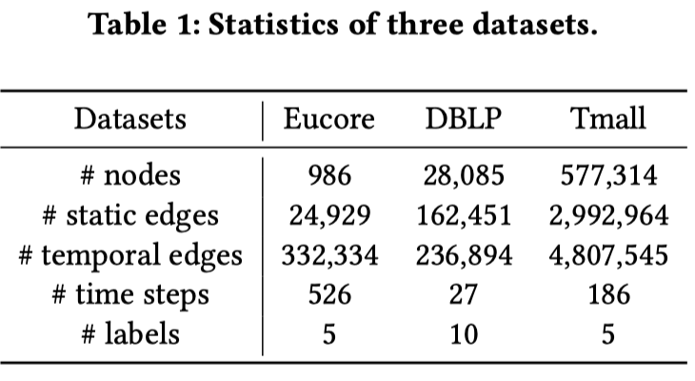
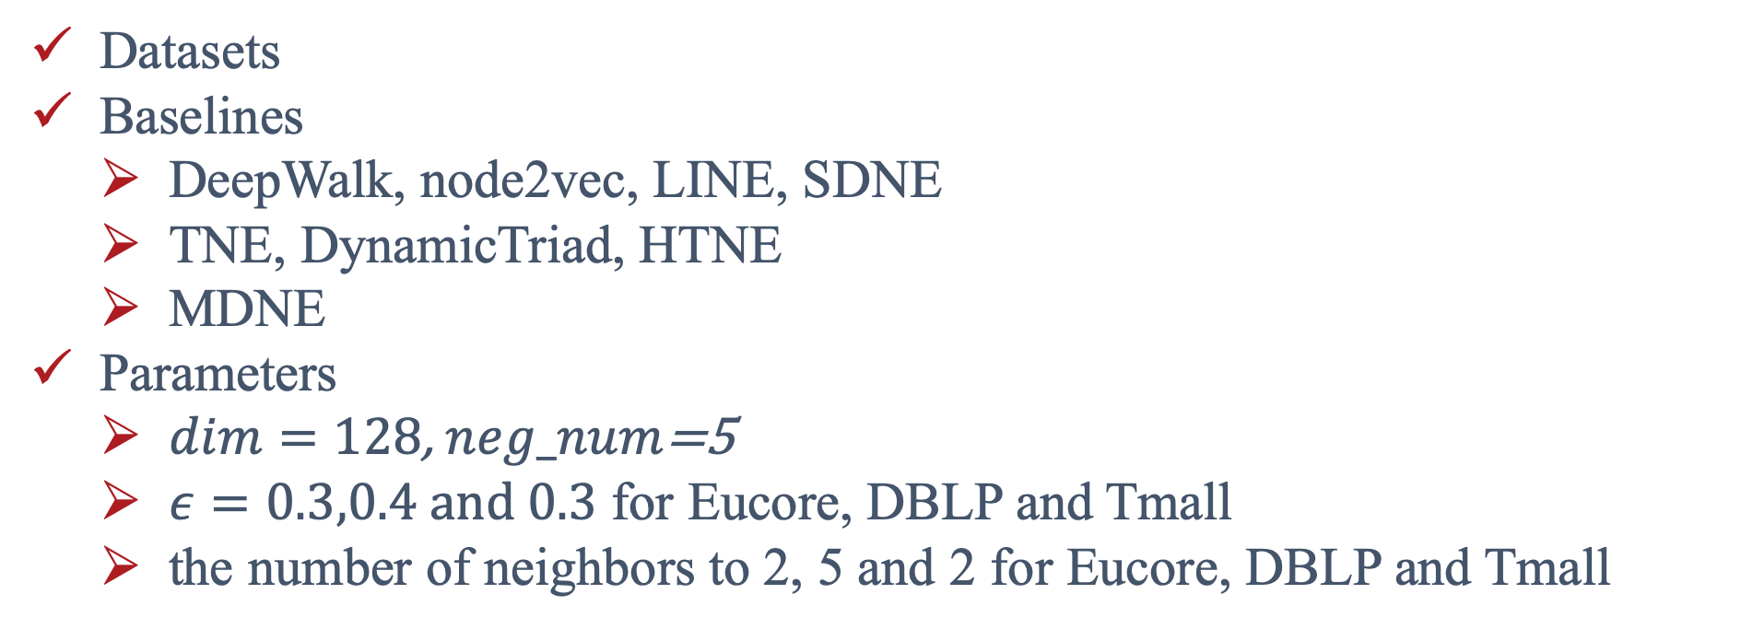
Experiments | Settings
Datasets
Baselines
DeepWalk, node2vec, LINE, SDNE
TNE, DynamicTriad, HTNE
MDNE
Parameters
$dim=128$, $neg_num$=5
$ε=0.3,0.4 and 0.3$ for Eucore, DBLP and Tmall
the number of neighbors to 2, 5 and 2 for Eucore, DBLP and Tmall

Slide 22
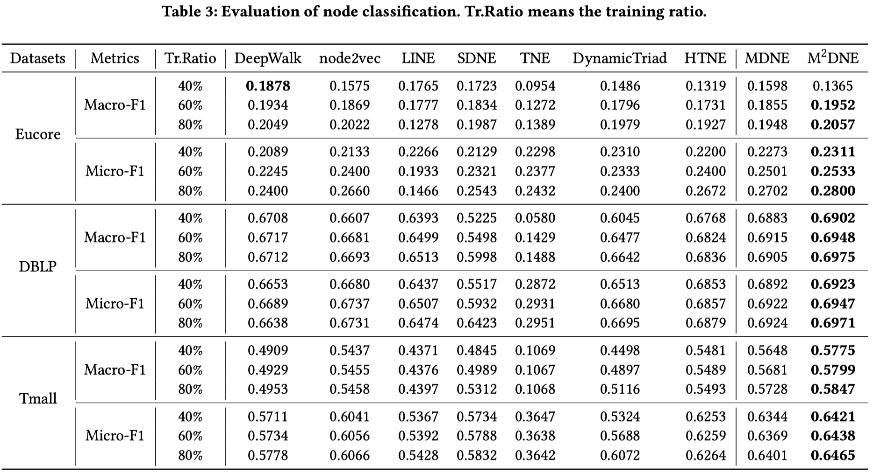
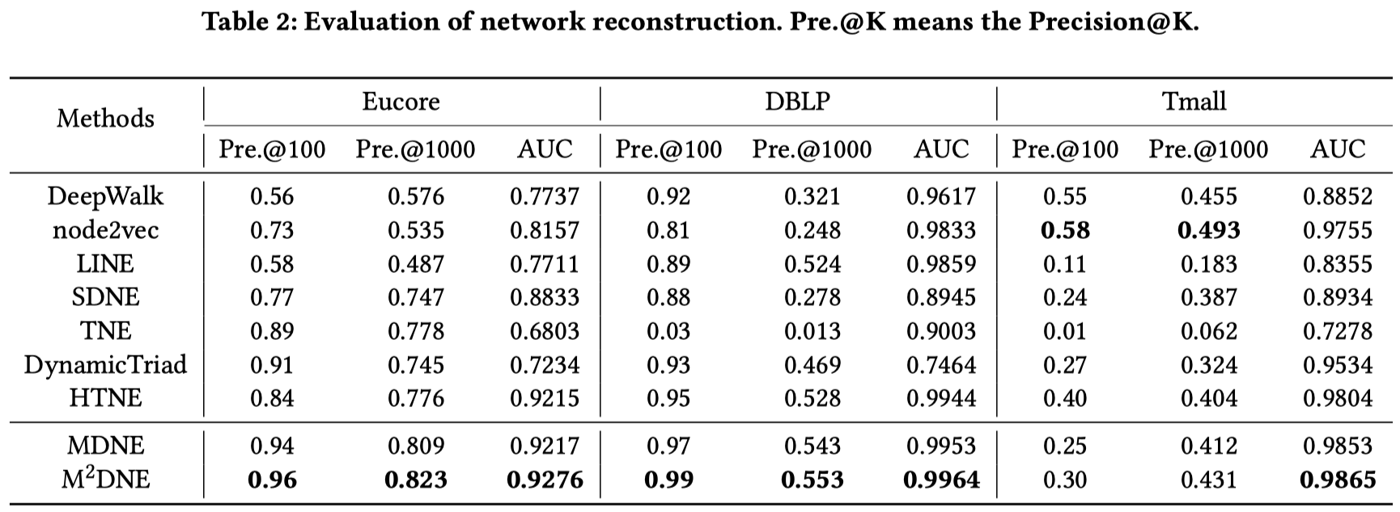
Experiments | Q1: Accuracy
Network Reconstruction
Node Classification

Slide 23
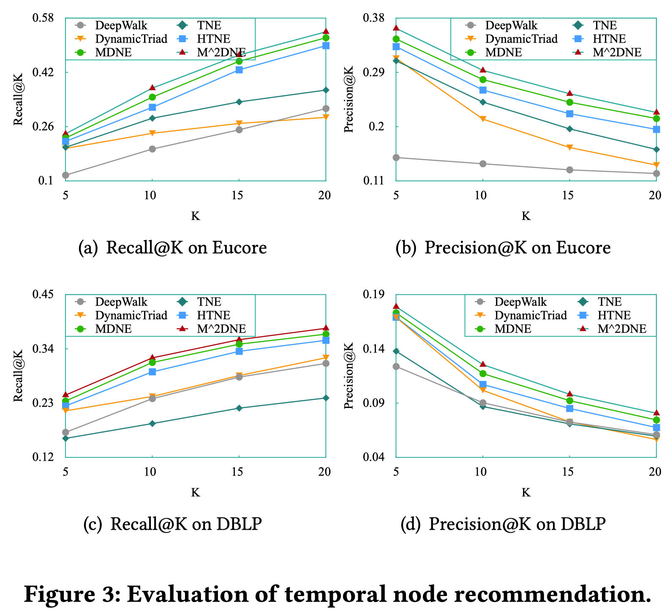
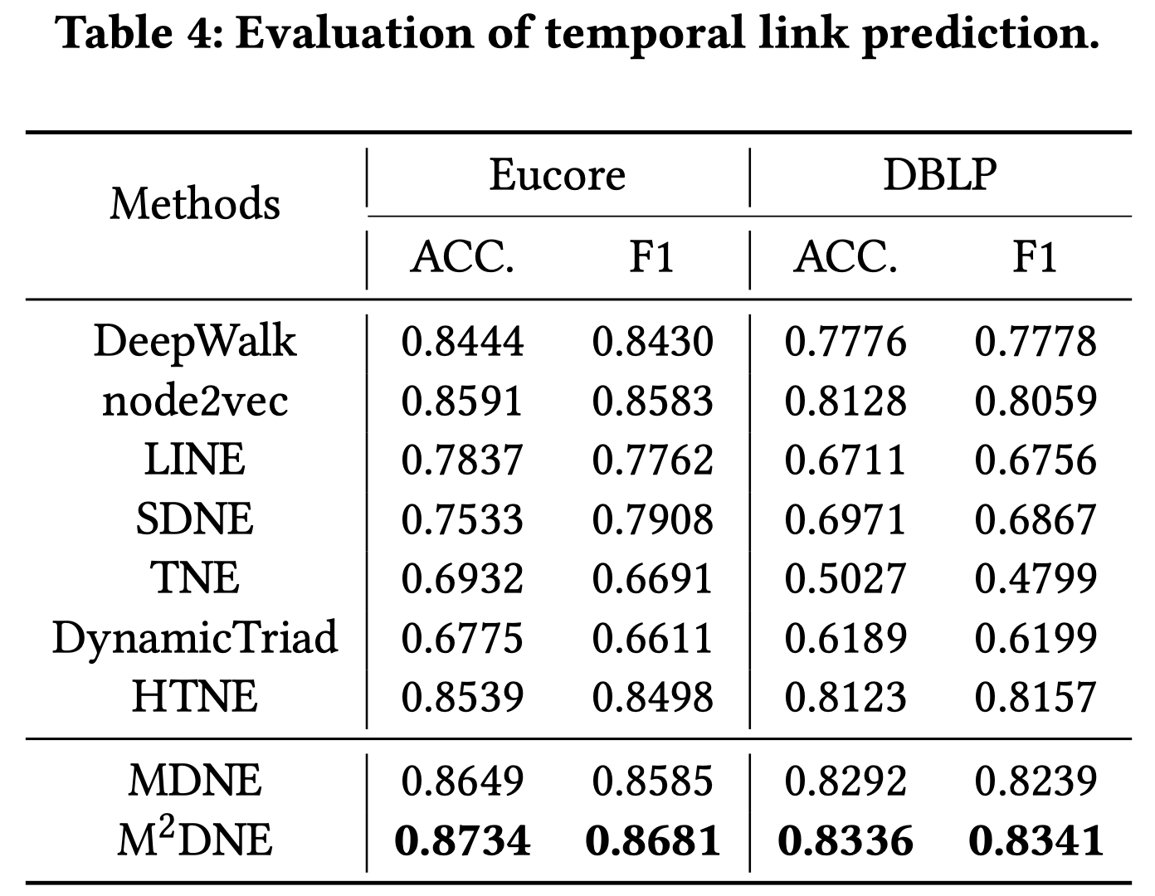
Experiments | Q2: Dynamics
Temporal Node Recommendation
Temporal Link Prediction

Slide 24
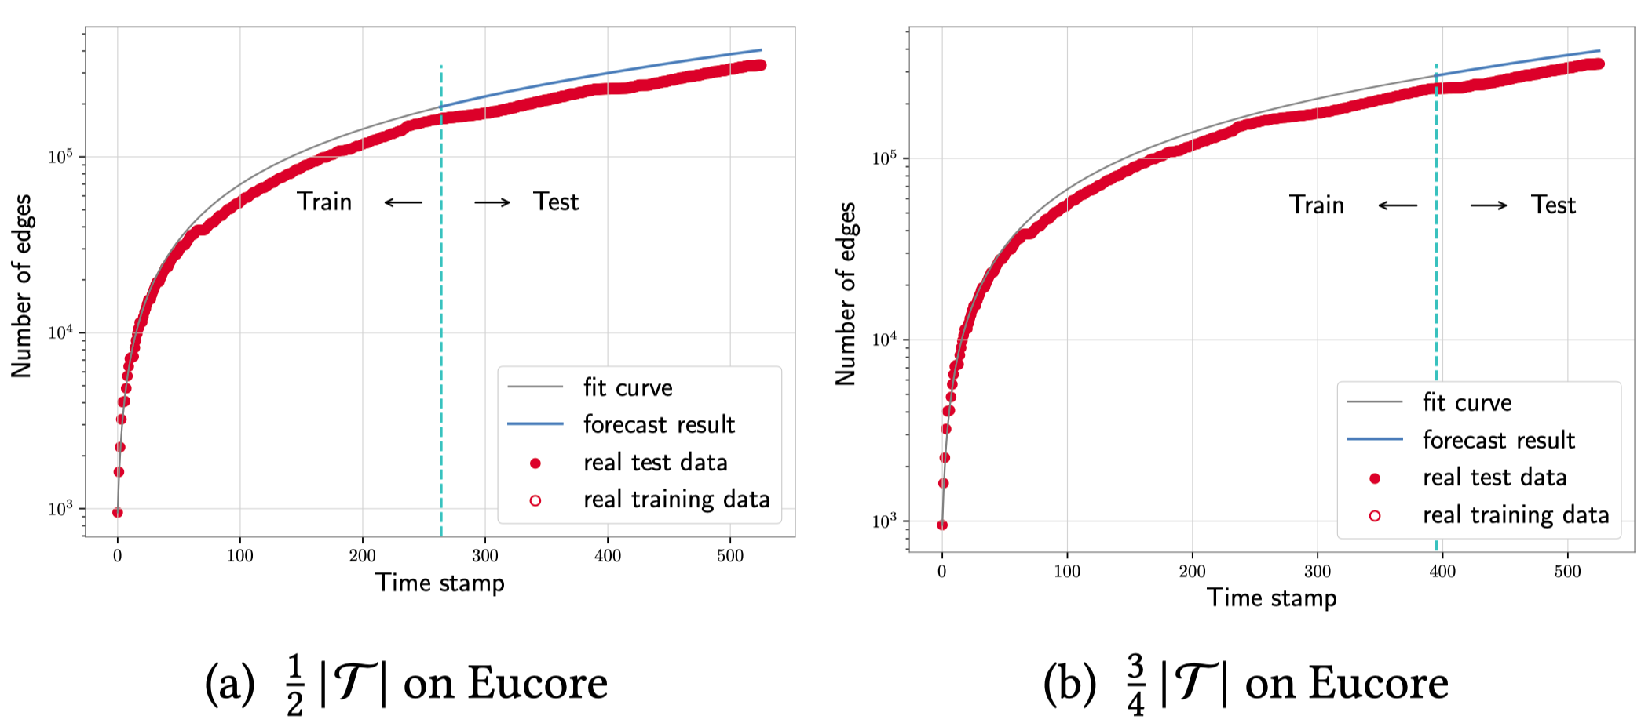
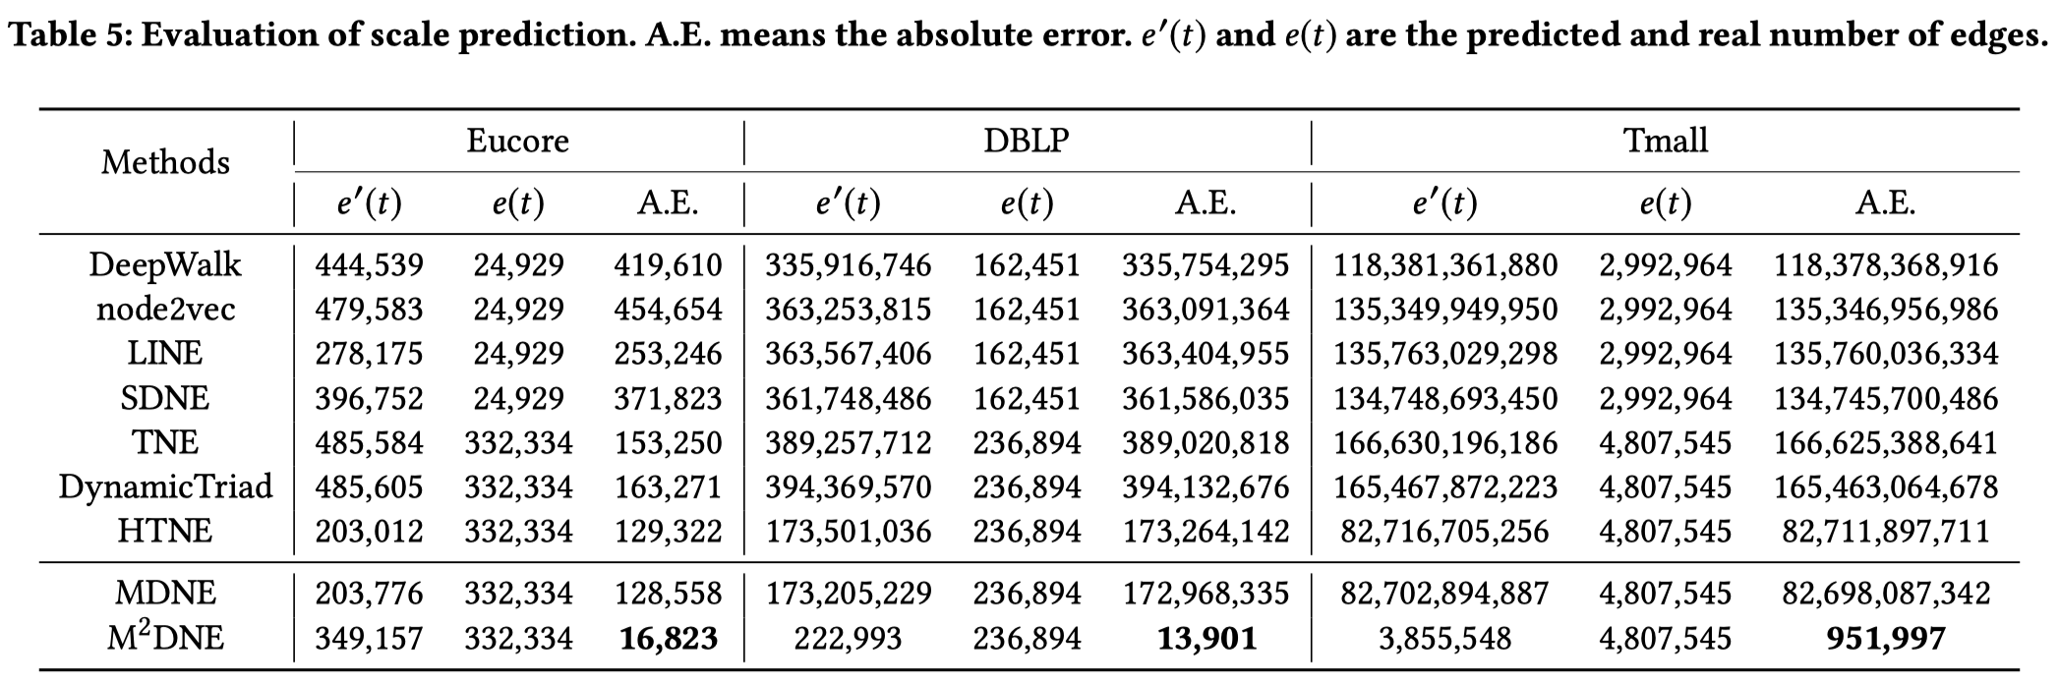
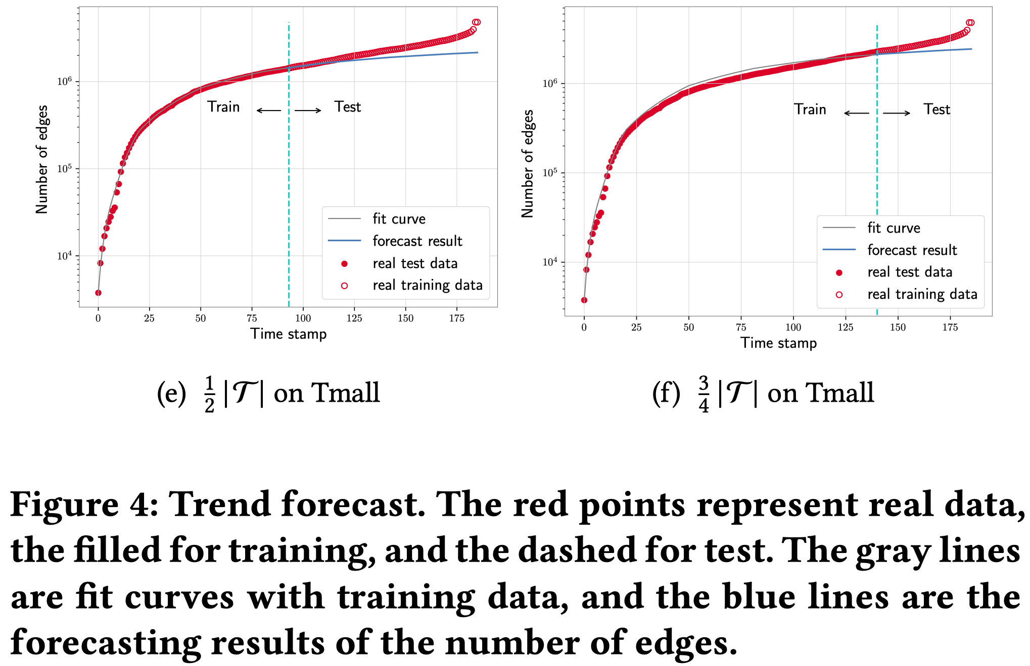
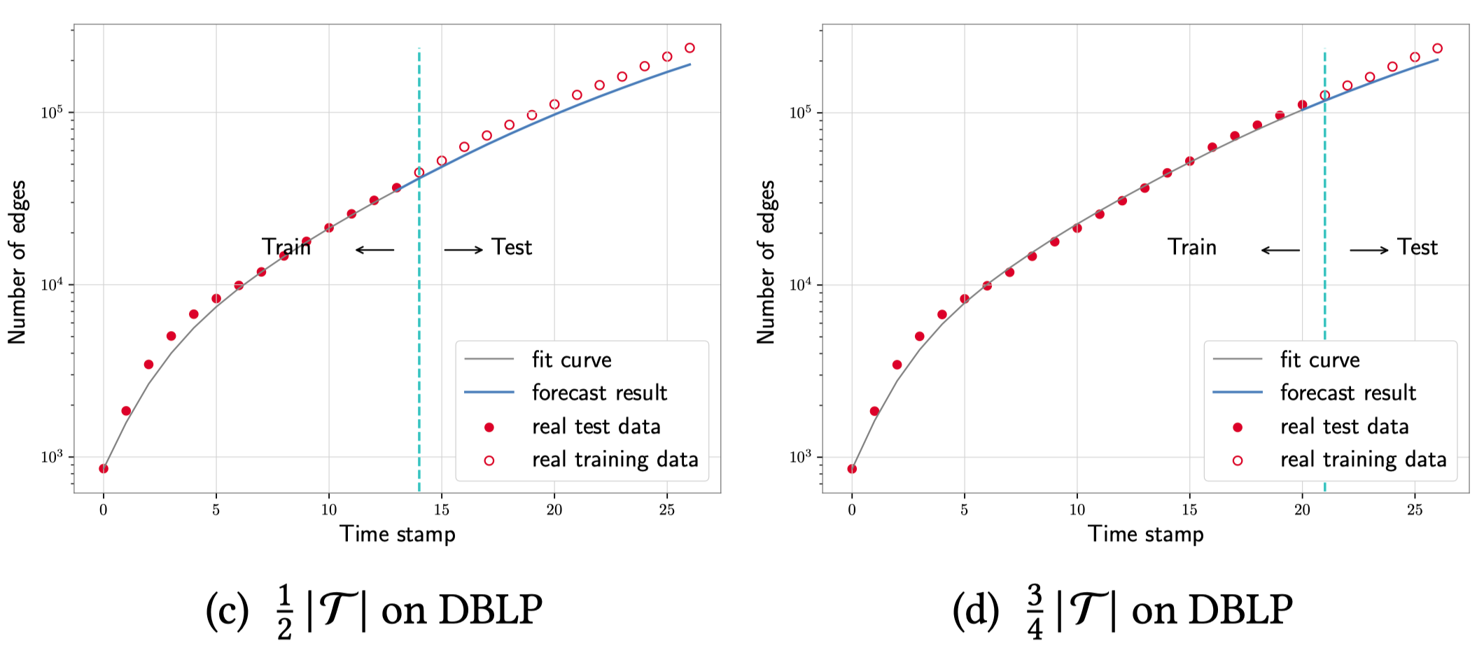
Experiments | Q3: Tendency
Scale Prediction
Trend Forecast

Slide 25
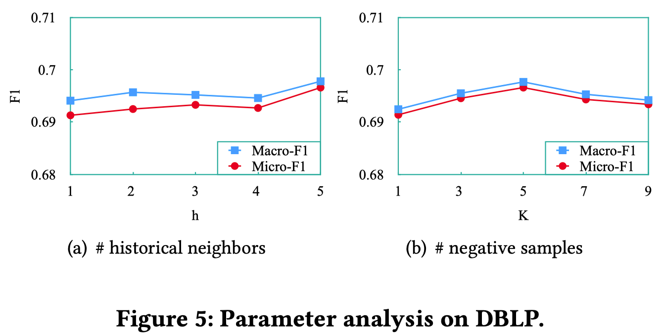
Experiments | Parameter Analysis
Number of Historical Neighbors
Number of Negative Samples.

Slide 26
1
Background
CONTENTS
2
$${\text{M}}^{\text{2}}\text{DNE}$$
3
Experiments
4
Conclusions

Slide 27
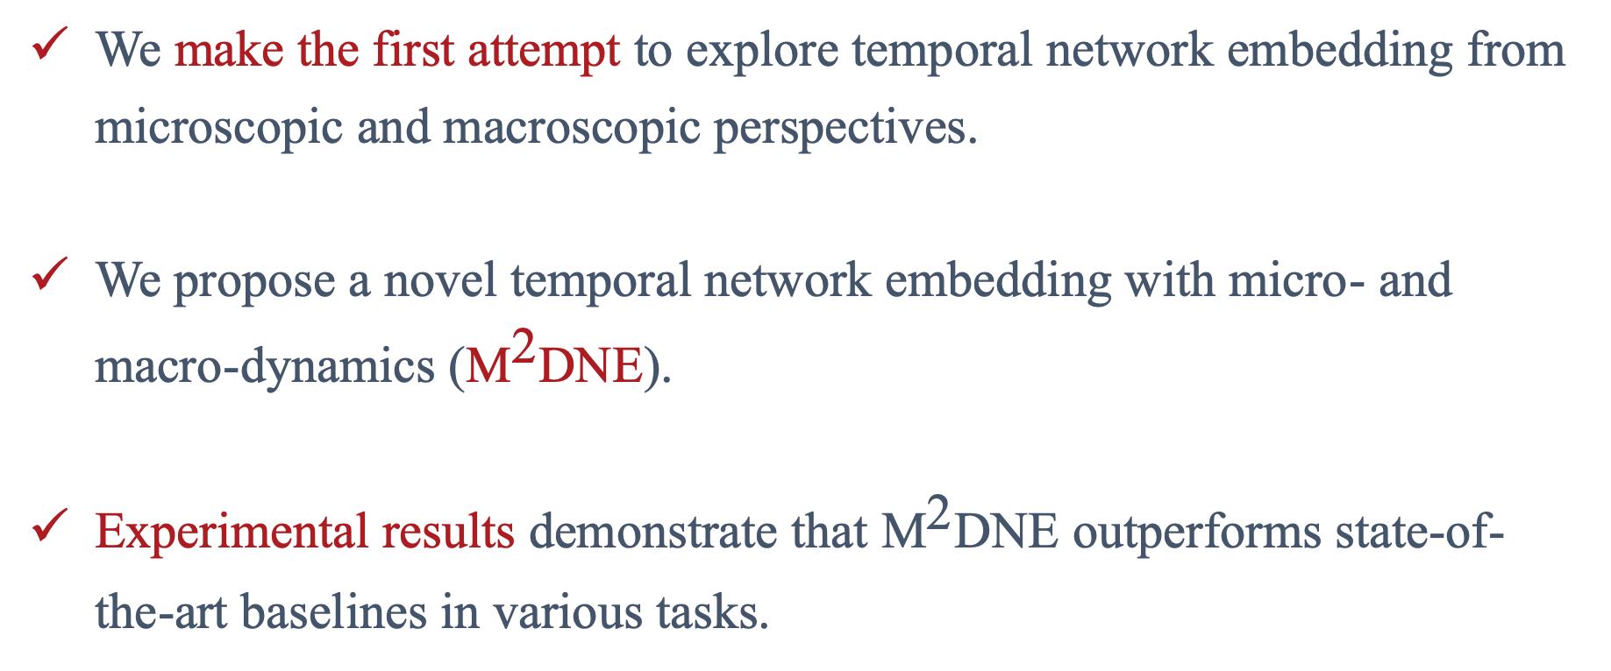
Conclusions
We make the first attempt to explore temporal network embedding from microscopic and macroscopic perspectives.
We propose a novel temporal network embedding with micro- and macro-dynamics (${\text{M}}^{\text{2}}\text{DNE}$).
Experimental results demonstrate that ${\text{M}}^{\text{2}}\text{DNE}$ outperforms state-of-the-art baselines in various tasks.

Slide 28
Thank you !
Q&A
Code and datasets:
http://github.com/rootlu/MMDNE or http://shichuan.org

